Slide 1
CSC 468 - Artificial Intelligence ROBOT READER
Professor: Nathalie Japkowicz
Samriddh Gupta

Slide 2


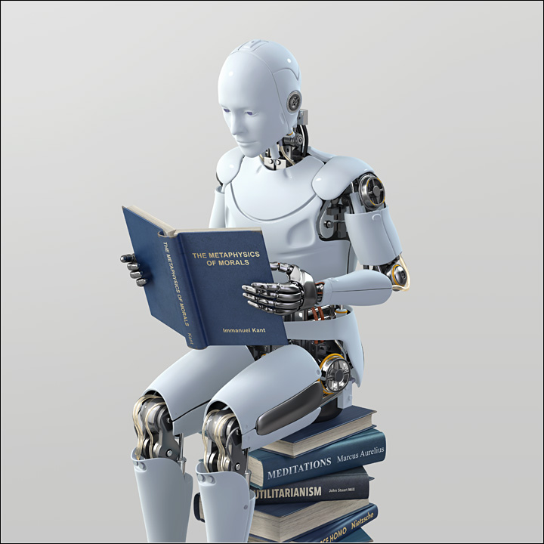
WHAT IS ROBOT ?
It is a program that uses artificial intelligence to read, edit and grade an essay.
By Implementing this program, professor and teacher can be excused from a task of assignment checking and grading is a difficult and time-consuming job and with help of this robot, we can do that job in less than a minute.

Slide 3
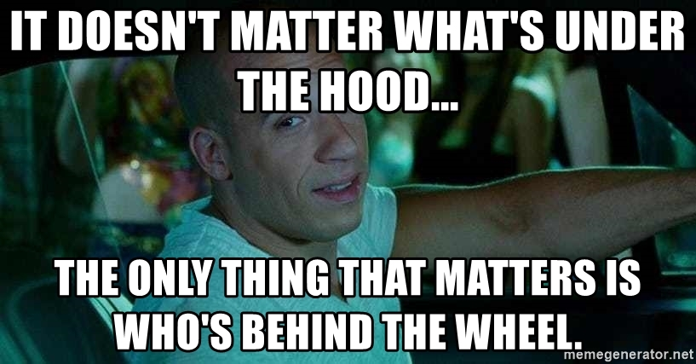
What’s under the hood?
This programing language uses following technology to work:
1. Machine Learning
2. Deep Learning
3. Cloud Computing
4. Statistical Analysis

Slide 4
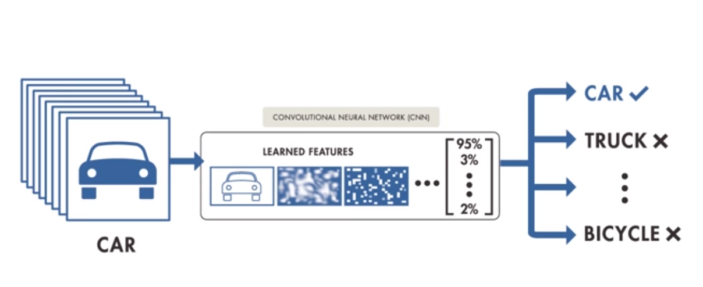
DEEP LEARNING

Slide 5
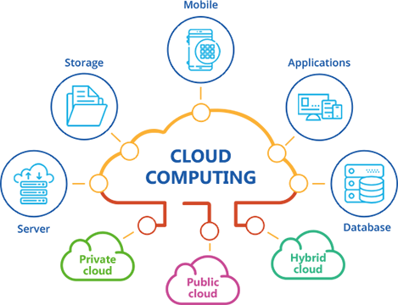
CLOUD COMPUTING

Slide 6
REFERENCES
http://www.johnharwood.com/gallery_tech_robot_reader.html
https://memegenerator.net/instance/80344478/toretto-tips-it-doesnt-matter-whats-under-the-hood-the-only-thing-that-matters-is-whos-behind-the-wh

